Slide 1
Congenital CMV
South Dakota Newborn Screening Forum
4/2026

Slide 2
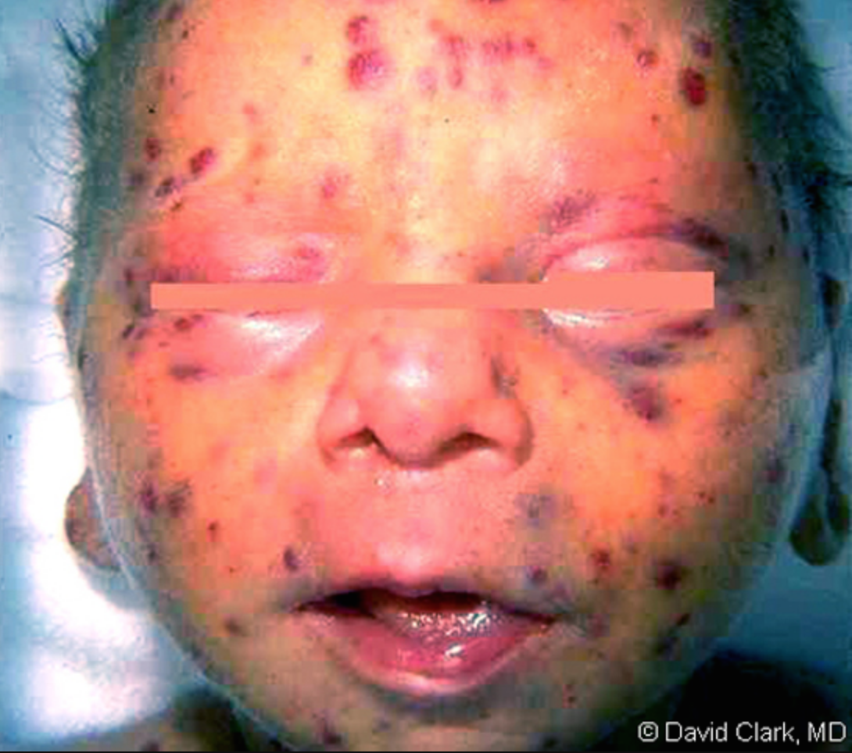
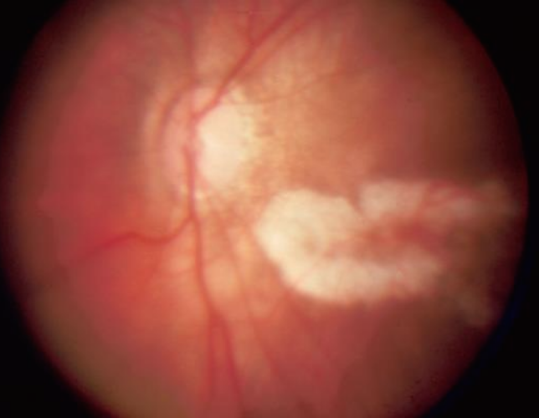
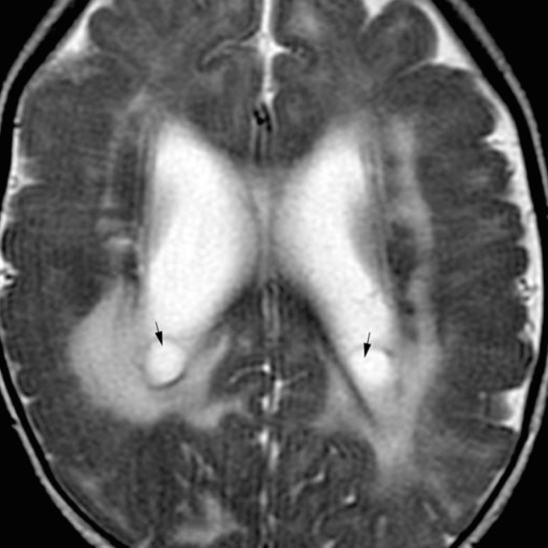
Redbook Atlas of Pediatric Infectious Disease, 2020
Notes:
Perivascular infiltrates (retinitis)
Germinolytic cysts

Slide 3
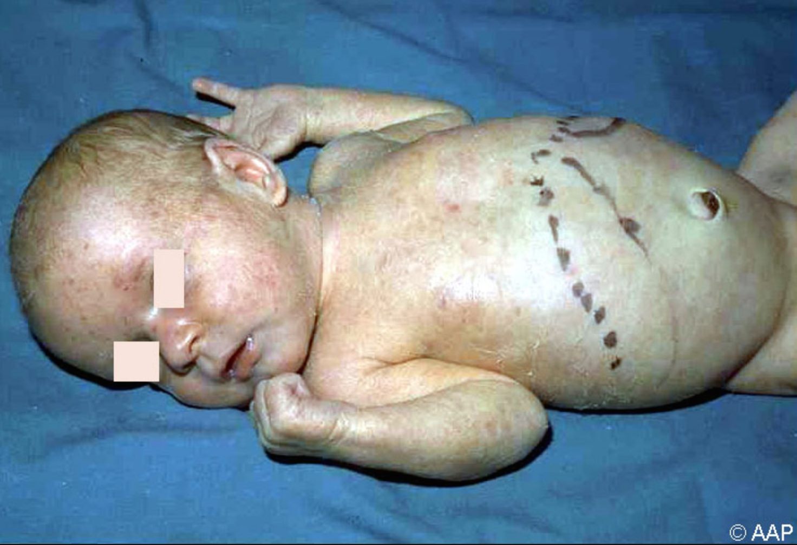
8
Redbook Atlas of Pediatric Infectious Disease, 2020

Slide 4
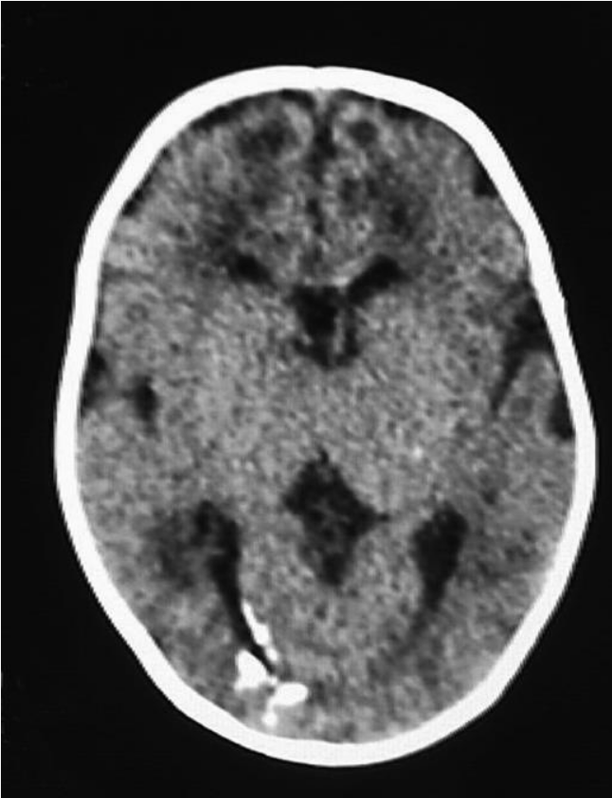
Redbook Atlas of Pediatric Infectious Disease, 2020

Slide 5

Approximately 90% of patients with cCMV are asymptomatic

Slide 6
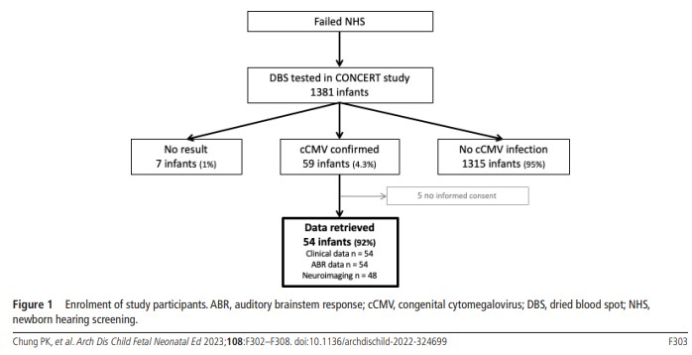
Targeted screening using failed hearing screen
Only 4% of babies with failed hearing screen has cCMV
~90% of cCMV babies are asymptomatic
Notes:
Failed hearing screen is not the only manifestation of cCMV and SNHL from cCMV can have delayed onset
And failed hearing screen DOES not mean patient has cCMV either = 4% of patients with hearing screen has cCMV. 90% of asymptomatic babies

Slide 7
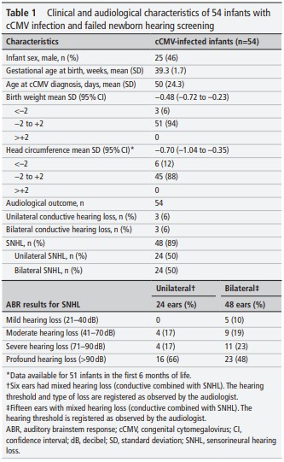
Pui Khi Chung, et al. Arch Dis Child Fetal Neonatal Ed. 2023 May;108(3):302-308
Notes:
This study shows that either unilateral or bilateral can be a manifestation of cCMV with SNHL

Slide 8
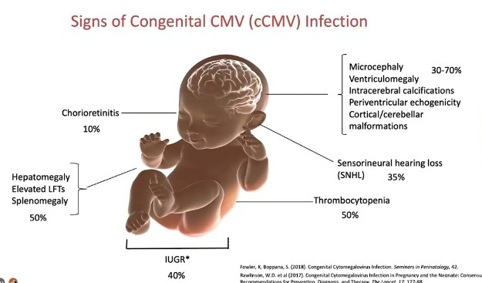
About 40% of asymptomatic babies at birth will ultimately develop SNHL
Congenital CMV is the leading cause of non-genetic SNHL in the United States.

Slide 9
Cytomegalovirus
Etiology: CMV – also known as HHV-5 – a member of family Herpesviridae family. Viral genome contains double-stranded DNA which is the largest of human herpesvirus genomes
Epidemiology: Highly specific and only infects humans. Virus is ubiquitous and exhibit extensive genetic diversity. Transmission occurs horizontally (secretions, STI), vertically (in utero, at birth and perinatally), and through blood products, organ transplants. Symptomatic infection can occur throughout the lifetime of an infected individual under conditions of immunosuppression. Protective immunity is very unclear.
4 periods of increased incidence: In-utero (cCMV), early childhood, adolescence, childbearing years*
Diagnosis: Confounded by ubiquity of virus, high rate of asymptomatic excretion and frequency of reactivated infections. PCR (saliva<urine in neonates), serology by IFA/latex agglutination/EIA

Slide 10
Cytomegalovirus
Congenital CMV ~ 1:200 babies
  SD has 11,000-12,000 babies annually (~55-60 babies a year)
~90 % of these babies are asymptomatic
In Avera, we had a total of 23 cases (1 not part of report yet, 1 tested somewhere else) since 2022 (~1.6% positivity in testing)
  Numbers increased since we started universal screening in the NICU
  Also increased awareness among our clinicians
  Brought about by timely screening – Avera has in-house testing through urine PCR

Slide 11
Avera cCMV Diagnosis Graph
Avera Peds ID Clinic

Slide 12
54%
75%
Dec 2024- Nov 2025
13/1063 = 1.3%
Dec 2023- Nov 2024
8 of 292 = 2.74%
Overall
21 of 1303 = 1.6%
38%
25%
8%

Slide 13
Condition | Approximate Birth Prevalence | How it is detected | Intervention | Outcome
cCMV | ~1:200 | Saliva/urine/dried blood PCR (within 28 days) | Valganciclovir treatment, prolonged audiology and ophthalmology screen; neurodevelopmental follow up | Can improve neurodevelopmental outcome by surveillance/ancillary intervention
Congenital hypothyroidism | ~1:2,000-4,000 | TSH/Blood | Thyroxine replacement | Normal development
PKU | ~1:10,000-15,000 | Blood | Low phe-diet | Normal intelligence. Prevents severe ID
Biotidinase deficiency | ~1:60,000 | Enzyme assay | Biotin | Normal neurodevelopmental outcome
Galactosemia | ~1:30,000-60,000 | Enzyme assay | Removal of galactose | Prevents liver failure and sepsis

Slide 14
Testing
cCMV diagnosis should be made within first 28 days of life (preferably within 3 weeks) otherwise it would be impossible to differentiate cCMV from post-natal CMV
Urine (most sensitive)
  More cost effective
Saliva (acceptable) → needs to be confirmed by urine test (which implicates not that cost effective)
Blood (not that sensitive, but specific)
  Cannot be a good screening test, does not have high rate of false positive

Slide 15
cCMV
The key here is timely diagnosis (within 28 days of life, preferably 21 days) since 90% of babies with cCMV are asymptomatic. Of which, at least 40% will develop SNHL at some point in their lives which may or may not be diagnosed in a timely fashion.
Missed cases may have occult progressing neurodevelopmental issues that may not be addressed correct through ancillary measures
Timely treatment has been shown to improve neurodevelopmental outcomes at 2 years of age (Boppana, S. B., Ross, S. A., & Fowler, K. B. (2013). Congenital cytomegalovirus infection: clinical outcome. Clinical infectious diseases, 57(suppl_4), S178-S181.)

Slide 16
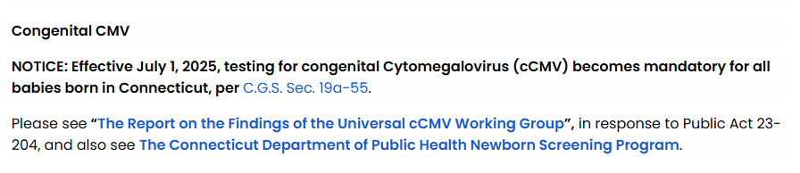
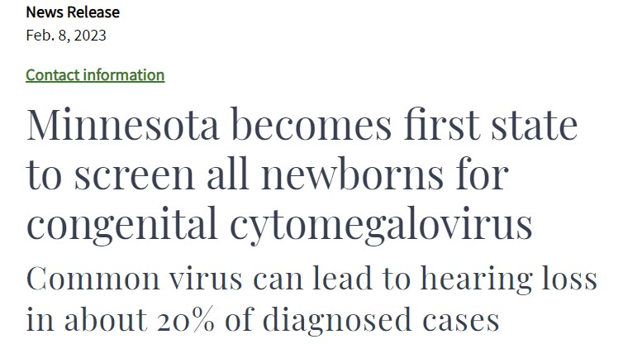

Nationwide Children’s in Ohio, Alberta, Saskatchewan, Manitoba, Ontario are also doing universal screening
Notes:
Nationwide in Ohio, Florida,

Slide 17
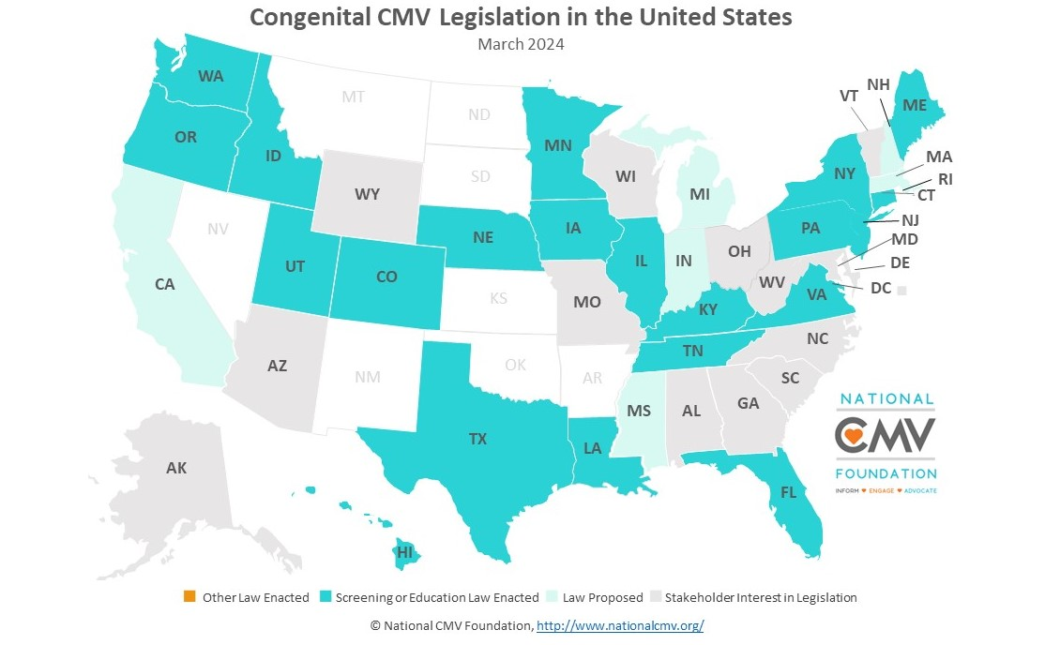
https://www.nationalcmv.org/about-us/advocacy
Notes:
https://www.entnet.org/resource/state-ccmv-laws/

Slide 18
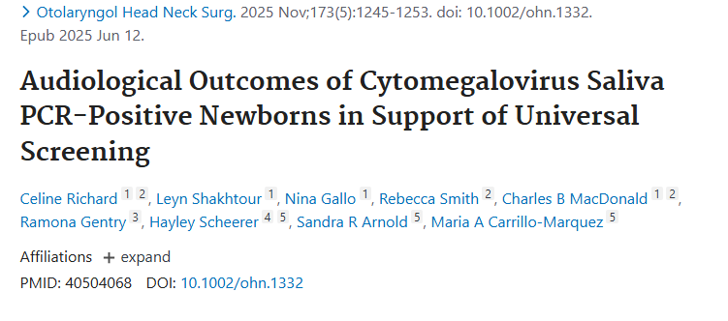

Slide 19
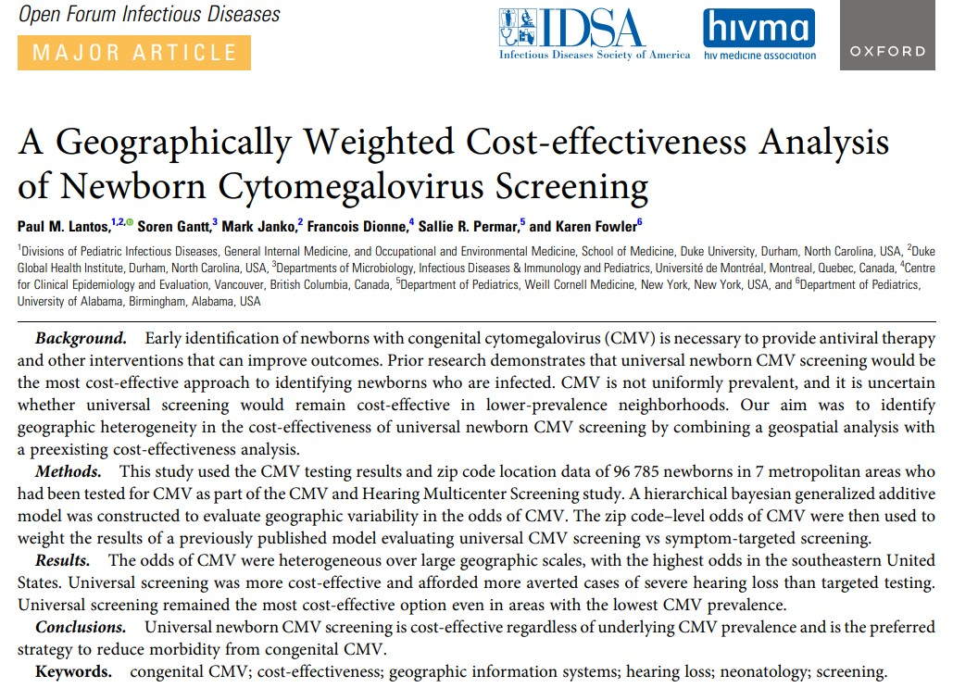

Slide 20
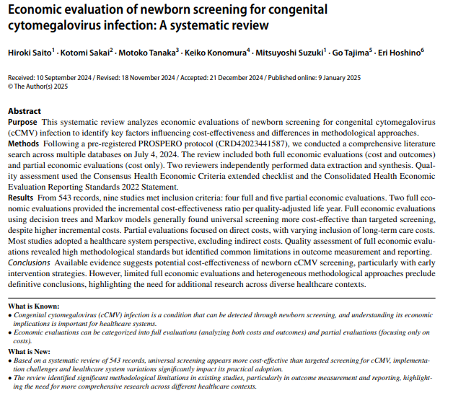

Slide 21
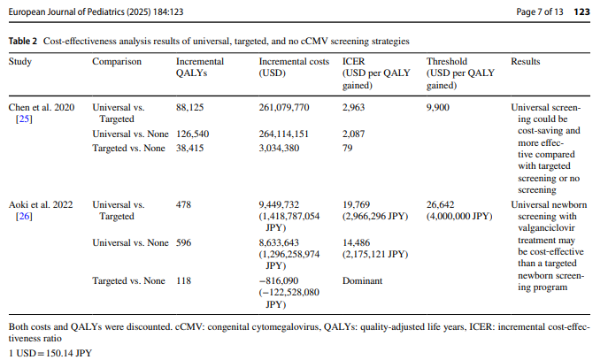

Slide 22
Conclusion
cCMV is an important congenital infection with real life long complications; leading cause of non-genetic SNHL in children and major cause of neurodevelopmental dysfunction
90% of cCMV babies are asymptomatic
Timely diagnosis of cCMV within 21 days is critical
There is treatment for 10% of these babies when diagnosed in time
cCMV babies needs prolonged ancillary surveillance
Universal screening has important positive economic implications
There is a need for us to evaluate the importance of doing universal screening among newborns

Slide 23
Thank you

