Slide 1
Foodborne Outbreaks: How Healthcare Facilities & Long-term Care Can Help
April 9th, 2026

Slide 2
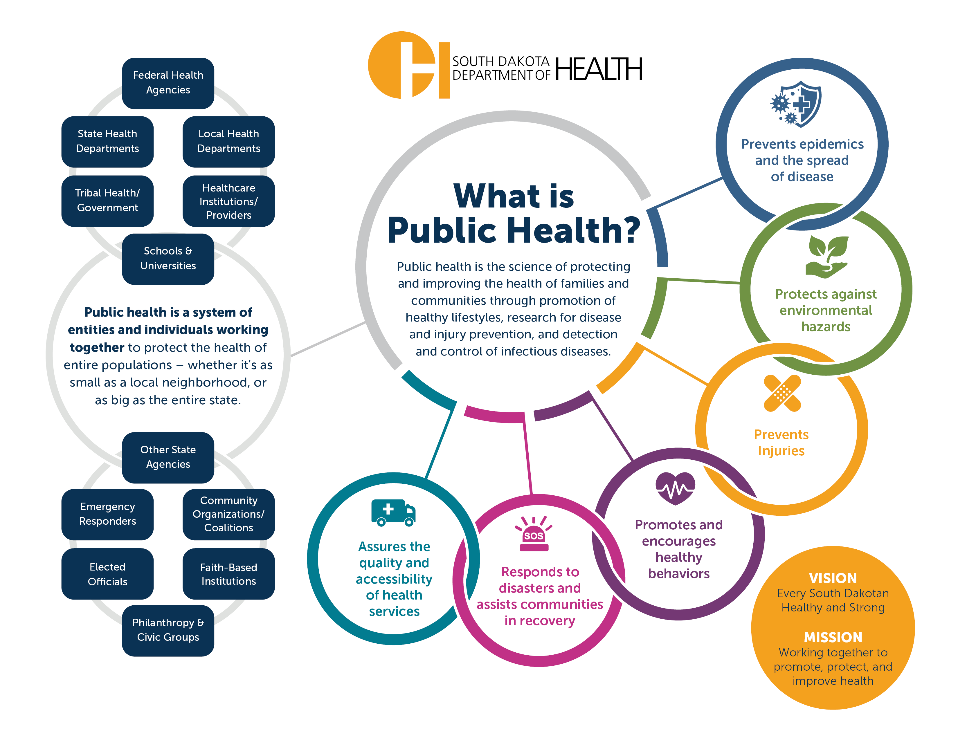
Title

Slide 3
Our Speakers…
Jessica Williams, MPH
Enteric Disease Epidemiologist
South Dakota Department of Health
Keegan Mason and Associates
James Keegan, MD Infectious Disease Specialist
Randee Mason, RN

Slide 4
My role
Data, data, data
Outbreak coordination
Share data with public & partners
Foodborne & enteric disease monitoring
Data quality
Analysis and interpretation
Reporting
Education & recommendations
Internal partners
Subject Matter Expertise
Understand how germs spread
Non-regulatory
Education & recommendations
External partners
Public health partners and agencies
Notes:
Hi as mentioned, my name is Jessica, and I an epidemiologist for the SD Department of health. My role involves reviewing health data, specifically around foodborne and enteric diseases, monitoring trends in these diseases, ensuring data quality and analyzing and interpreting that data. I also have to have a pretty good graps of how those germs spread, so that I can provide education and be able to answer questions. As an epidemiologist, I do not regulate anything, I am really working with the data and understanding the science of these diseases are spreading across the state. One other aspect of my role is outbreak coordination, which includes working with both internal and external partners, and other public health agencies when appropriate. Lastly, I get to share some of the data and the science that we learn with the public and our partners, which is why I am really happy to be joining you all today on this call so that we can talk a little bit about foodborne diseases.

Slide 5
Enteric Diseases
Salmonella
Listeria
STEC
Shigella
Cryptosporidium
Giardia
Campylobacter
Cyclospora
Vibrio
Notes:
Disease of the intestinal tract
Diarrhea and vomiting, sometimes fever or abdominal cramps
30+ germs cause this illness
Bacteria, viruses, parasites
Incubation periods vary

Slide 6
Transmission
Fecal-oral route
Foodborne
Waterborne
Zoonotic
Person to Person
Environmental
Notes:
These germs are typically spread through the fecal oral route, and are often associated with food poisoning, but enteric diseases are not always foodborne. They can also spread through contaminated water, contact with animals or their environment, or after contact with an ill person or contaminated surfaces. Some pathogens survive better in the environment, than others, and some are better at spreading from person to person.

Slide 7
CDC Estimates (2019)
6 major pathogens caused an estimated 9.9 million illnesses nationally
Over 53,000 hospitalizations
931 deaths
Top causes of illness: Norovirus, Campylobacter, Salmonella, C. perfringens, and Shiga-toxin producing E. coli (STEC)
Top causes of hospitalizations: Norovirus, Campylobacter, Salmonella, STEC and Listeria
Notes:
To give a little bit of background, I wanted to share a few statistics from the CDC estimates on foodborne pathogens. the CDC determined that among the 6 major pathogens, there were 9.9 million illnesses during 2019, and over 53,000 hospitalizations and 931 deaths during the same time period. The major pathogens included norovirus, campylobacter, salmonella, c perfringens and STEC. While less commonly causing illness, Listeria was a more common cause of hospitalization than clostridium perfringens among the pathogens analyzed.

Slide 8
Chain of Infection
Pathogen
Reservoir
Portal of Exit
Mode of Transport
Portal of Entry
Susceptible Host
Notes:
So, some of you may already be familiar with this, especially if you have ever taken a public health course, but especially when talking about outbreak response, it is helpful to keep the chain of infection in mind. In order to stop new illnesses from occurring, the chain only needs to be broken in one place. For foodborne or enteric diseases, something as simple as handwashing after using the bathroom or changing diapers, or before eating or preparing food may be enough to break the chain at the portal of exit or entry. Similarly, if we can identify a contaminated food product and work with partners to implement a recall and get product off the shelves and out of peoples kitchens, that may be another opportunity to stop the spread, which is one of the main goals of outbreak response. As a result, being able to identify what is causing an outbreak and how that pathogen is spreading within a population is really key here.

Slide 9
Title
Reported to DOH
Get tested
Seek Healthcare
Ill persons in population
Notes:
As many folks on this call are likely aware, many folks who have diarrheal symptoms or vomiting due to viral or bacterial infections do not seek healthcare. This may be because symptoms are self limiting, or they recover from symptoms within a relateivel yshort time.
Of those who do seek healthcare, not all providers will order testing, or patients may decline specimen collection even if testing Is offered. Of those that are tested, there is the possibility for false negatives to occur, or for results to go unreported to the health department either due to staff turnover or something like that. As a result, the number of cases reported to the department are likely just a small portion of what is truly going on within a community. Past CDC estimates have suggested that between 1 in 30 cases of salmonella in the U.S. actually get reported, largely due to people not seeking healthcare or being tested.
As a result, even a small cluster of 2 or 3 cases likely indicates that there are more people sick with a population. The cases that we know about are likely just the tip of the iceberg, especially when we are talking about the spread of disease in community settings.

Slide 10
To Test or Not to Test…
When should testing be sought?
Illness over 72+ hours
Severe disease or hospitalization
Multiple people ill
Pathogen Identification is Important
Understand risk of spread
Interventions
Treatment recommendations
Notes:
The majority of folks who experience gi illness do not seek care or get tested, but in outbreak situations, testing is really important for understanding what is causing illness, how it is spreading, and interventions that can be taken to stop the spread. If illness is severe, lasts more than 72 hours, or there are multiple people ill, testing is recommended. Testing can also help identify if this is part of a larger outbreak happening across SD or in other states. So if we do suspect an outbreak, we are generally going to want to confirm that with laboratory evidence.

Slide 11
Testing Support
SDDOH can provide some testing support to identify pathogens causing an outbreak in long term care settings
3-5 samples generally recommended
Active symptoms → more likely to get a positive result
Notes:
Specifically for long term care facilities, SDDOH can offer limited testing support for facilities experiencing outbreaks. Generally 3-5 samples from folks actively having symptoms are recommended to identify an outbreak etiology, but this can also be done in house or at an affiliated lab if your facility is associated with larger healthcare system. That may provide more timely results than sending it to the PHL, but be aware support may be available if your facility needs help or has questions regarding testing.
Also, be aware that it is typically best to collect samples from folks who are actively havin symptoms, as this is the time when you are most likely going to be able to successfully identify a pathogen in that sample.

Slide 12
What needs to happen to get results…
Illness Onset
Seeks Medical Care
Testing
Specimen Sent to SDPHL
Reflex Culture
Whole Genome Sequencing
Analysis of Results
Results reported to Department of Health
DOH Staff Call Patient for Interview
Pathogens that are routinely sequenced at the Public Health Lab:
Salmonella, Listeria, Shigella, E. coli (shiga toxin-producing), Vibrio species
Notes:
So there are a few different things that need to happen before a disease report gets to the health department. After illness onset, a patient needs to seek medical care and testing, which as was already mentioned doesn’t always happen for a variety of reasons. If a test does come up positive however, results are reported to DOH usually electronically, and a DOH staff member will review the results and conduct a chart review prior to reaching out to a patient for interview. While that process is starting, if the pathogen identified at the clinical lab is a major foodborne bacterial pathogen such as listeria or salmonella, laboratories across the state routinely send those specimens to the Public health lab in Pierre for further analysis. If the pathogen was detected by PCR or antigen tests, the public health lab will likely need to reflex culture that specimen in order to obtain an isolate for sequencing. For enteric diseases isolates are analyzed through a process called whole genome sequencing, and results are analyzed to see if similar strains are popping up in ill persons across the state.
This whole process usually takes at least 2-3 weeks, so by the time we are following up with someone about exposures we are usually asking about a time frame several weeks in the past.

Slide 13
Whole Genome Sequencing (WGS)
What is WGS?
Replaced PFGE
Sequences the genes of pathogenic organisms
Can compare results between isolates
Routinely sequenced: Salmonella, Shigella, STEC, Listeria, Vibrio
What information do we get from WGS?
Species & Serotype
Shiga toxin type
Predicted Resistance
Reoccurring, Emerging or Persisting (REP) strains
Track outbreaks, track strains over time
Notes:
Whole genome sequencing or WGS is a technique used to sequence and analyze a genome. In this case we are using to analyze the genome of pathogenic bacteria, and this method has replaced pulse field gel electropheresis or PFGE. We can compare results between isolates from across the state and even the country to see if there are multiple folks ill with the same strain of bacteria. Pathogens that are routinely sequenced in SD include salmonella, shigella species, Shiga toxin producing e. coli listeria, and vibrio.
In addition to comparing the genetics of individual isolates, there is also a wealth of other information that can be obtained from sequencing results, including species and serotype information, shiga toxin type, predicted resistance to antibiotics, and we can identify outbreaks, and track strains over time. One thing I do want to point out is that WGS is not approved for diagnosis or making treatment decisions

Slide 14
DOH investigation of reportable diseases
Initial Interview
Chart Review
LTCF: Sources
Patient Interview
Recommendations
Individual
Facility
WGS results
Follow up interview
Records Requests
Notes:
SDDOH follows up with case patients or their family for reportable conditions. The initial interview usually starts with a Disease intervention specialists within DDPC conducting a chart review, and in cases where a patient is either hospitalized or residing in a LTCF, they may reach out to the care team for more info before reaching out to the patient for interview. In addition to collecting exposure information, there is also an opportunity to provide recommendations and education, both for the individual and potential a facility, especially if the patient lives in a group setting. Lastly, if a cluster is later identified or we receive further test results linking a case to other cases, we may follow up with an additional interview to gain more clarity on exposures, and this may in turn lead to additional record requests.

Slide 15
How does DOH get notified?
Phone Call
Online Report
Disease Surveillance
Laboratory
Public Health Partners
Notes:
How does the department of health get notified or identify outbreaks? Well there are a few ways this happens. One way is healthcare providers or Infection Preventionists may submit an outbreak to the department either through an online report or phone call. Clusters or outbreaks can also be identified be through routine surveillance of reportable conditions, such as salmonellosis. Sometimes even before we have confirmatory results a cluster may be identified at a certain restaurant or childcare setting, or associated with a particular event. Next, laboratory analysis of whole genome sequencing results can also help identify outbreaks, and this is especially helpful for identifying outbreaks that span multiple states or jurisdictions. Lastly, other public health partners may also reach out if there is a public health concern.

Slide 16
Foodborne & Enteric Disease Spread in Healthcare Settings
Contaminated Commercial Food Item
Food Handlers
Direct Patient Care Staff
Environmental Contamination
Procedures & Practices
Notes:
So what are we looking at for clusters that are related to healthcare facilities, and how might pathogens spread in these environments? One possibility is a commercial food item that is contaminated with pathogens such as salmonella, listeria, or shiga toxin producing e. coli. Another possibility is spread through ill staff members, usually either food handlers or staff who are involved direct patient care. Another possibility could be spread through environmental contamination, such as on high touch surface like door handles or light switches, or shared bathrooms. Norovirus and shigella in particular are really good at spreading in this manner, in addition to person to person spread. Lastly, faulty medical devices or lack of adherence to sterilization or infection prevetion practices may also allow for the spread of disease within a healthcare facility.

Slide 17
Investigation Challenges
Food recall can be difficult
Individuals may not keep receipts
Not everyone who is sick seeks healthcare
Not everyone who seeks healthcare is tested
Food may not be available for testing at time of outbreak investigation or testing may be unsuccessful
Stealth vehicles (herbs, onions, sauce ingredients, etc.)
Notes:
There are several aspects of foodborne investigations that can create challenges. Food recall can be difficult; for example I would have to think for a minute if asked what I ate for lunch 3 days ago; this is more difficult if the time period we are asking about is 4-6 weeks ago.
Another challenge is that individuals may not keep receipts or other records that help with food recall and traceback. In addition, as mentioned before, not everyone seeks healthcare or gets tested, so we only know about a small portion of the folks who are actually ill. Food may also not be available for testing at the time of an outbreak, which is common for outbreaks caused by fresh produce. Even when food is available, it may not have been stored properly or the pathogen may have degraded enough that it is no longer able to be detected through standard testing methods. Lastly, stealth vehicles such as herbs or things like onions, may not be recognizable as an ingredient in a dish or may appear in multiple food items, making implication difficult.

Slide 18
Clusters & Sub-clusters
Sub-clusters
Demographics
Healthcare or Long-term care facilities
Daycares
Restaurants
Events or Gatherings
Notes:
So one of the first things we look at when a cluster or outbreak is identified, is demographics. Are cases clustering in a certain town or geographic area? Are we seeing several more cases in children or adults? Are they clustered within on incubation period? Next we look for any commonalities in potential exposures or places that folks may have frequented. For example, are we seeing a cluster of folks who all live at the same long term care facility, or attend the same daycare? Did folks frequent the same restaurant, or attend gathering or event? Finding –sub-clusters can be incredibly helpful, because it allows us to focus on a single meal, event, or exposure rather that trying to collect information on every meal or thing a person ate or drank within a 1-2 week period.

Slide 19
Records – Outbreak Response
Menus
Invoices
Notes:
So what kind of information or records might be requested if an outbreak or cluster is identified at a healthcare facility? Menus can be really helpful, because this can give us an idea of what a person ate during the incubation period for their illness. We can also cross reference this with food histories from people not at the facility to see what food exposures they could have had in common.
If a food product is suspected, invoices may also be requested for traceback efforts. This can help determine if folks were eating food from the same distributor, and/or producer.
Facilities tend to keep better records than individuals do, so the information provided through these records can be really helpful in solving outbreaks and identifying the sources of peoples illnesses.

Slide 20
Outbreak Example
Salmonella Sundsvall & Oranienburg
407 cases of illnesses reported in 44 states (+ Canada)
158 hospitalizations (44%)
47% were 65 years or older
52 people resided at long-term care facilities
44 attended childcare centers
6 deaths were reported
Cantaloupe identified as source of Salmonella outbreak
Several recalls issued as a result
Notes:
To provide an example, I wanted to discuss an outbreak of salmonella Sundsvall that occurred a couple of years ago. This is a fairly rare serotype of salmonella that is not seen very often in the U.S., so it was unusual to see a cluster pop up. Over 400 cases were ultimately linked together, spanning 44 states and even some cases were detected in Canada. Given how widespread the cases were geographically, this is clearly a situation where a contaminated food product was a likely source. In total, there also ended up big 158 hospitalizations, which put the hosp. rate at 44%, this is really high for salmonella. I usually consider 20-25% typical for salmonella. 6 deaths also occurred, so this was a pretty severe outbreak. A large portion of ill persons were older adults, and there were several sub0clusters in long term care facilities and childcare centers. These sub clusters were really helpful because as mentioned, menus and other documentation from such facilities can be really helpful for identifying a common food exposure among case-patients. Ultimately, cantaloupe was identified as the source of salmonella, with recalls issued as a result.

Slide 21
How You Can Help
Report outbreaks to DOH
Test patients – especially if there are others ill
Order antimicrobial susceptibility testing when appropriate
Food recalls
Records requests
Exclusion of ill staff and food handlers
Promote hand hygiene among patients, residents, and staff
Notes:
There are a number of ways that healthcare providers and healthcare facilities can help with outbreaks, First, report outbreaks to DOH, either through our website or via phone. Test patients experiencing GI symptoms, especially if there are others ill, either within your facility or if a patient reports others ill who may have been exposed in the community. Records can also be helpful in confirming suspected food products as an outbreak vehicle and can aid in justifying necessary food recalls.
Additional ways that healthcare and long term care facilities can help control the spread of foodborne pathogens is to exclude ill staff from duties that include direct patient care and food handling while ill. Especially during outbreaks that revolve around pathogens that can spread through both food and person to person spread, promoting handwashing among patients/residents and staff as well as implementing contact precautions may also help stop the spread.

Slide 22
Resources & Further Reading
Call me!
Foodborne & Enteric Disease Landing Page (SDDOH)
SDDOH Infectious Disease Dashboard
(CDC) Estimates: Burden of Foodborne Illness in the United States
CDC Outbreak Webpage, FDA & USDA Recalls
Notes:
I am happy to chat with healthcare providers, or infection preventionists if you have questions about reporting or outbreak response.
We also have a (relatively new) landing page on the SDDOH website that contains information about enteric diseases, reporting, and educational information and handouts, so feel free to check that out. The SDDOH Infectious Disease Dashboard is also updated monthly with case data on reportable conditions, and I have added a link to the CDC Estimate for the Burden of Foodborne Illness outbreak pages for your review. Lastly, there are also links to the CDC, FDA and USDA outbreak and recall pages of that is of interest.

Slide 23
Antibiotic Stewardship Considerations for Foodborne Infections
Goals
Review common causes of foodborne diarrheal illness
Identify situations where antibiotics are not needed
Recognize when treatment is appropriate
Apply stewardship principles to protect the microbiome and prevent resistance

Slide 24
Mild or Moderate Diarrhea
Treatment / Supportive Care:
Hydration
Bismuth subsalicylate (Pepto-Bismol)

Slide 25
Pathogens That May Cause More Severe Illness
Salmonella
Shigella
Campylobacter
Shiga toxin–producing E. coli (O157:H7)
Cyclospora
Listeria
Case examples
Epidemiology of organisms
Additional concerns
Epidemiology examples
Epidemiology / transmission testing

Slide 26
Pathogens That May Cause More Severe Illness
Clostridioides difficile
Norovirus
Klebsiella oxytoca (cytotoxin associated)
Vibrio vulnificus
Yersinia enterocolitica
Fever (~68%)
Bloody stool (~26%)
Case examples
Epidemiology of organisms
Additional concerns
Epidemiology examples
Epidemiology / transmission testing

Slide 27
Opportunities to Avoid Antibiotic Exposure
Mild–moderate diarrhea
Salmonella
E. coli O157:H7
Norovirus cause >90%
non-bacterial diarrhea
lasts 12–60 hours → Hydration
Traveler’s diarrhea
Consider Pepto Bismol
Klebsiella
Stop antibiotics

Slide 28
When Antibiotics ARE Indicated
Treatment may be appropriate in severe illness, high-risk patients, or specific pathogens.
Organism | Treatment
Salmonella | Ciprofloxacin or TMP/SMX
Shigella | Ciprofloxacin or TMP/SMX
Campylobacter | Azithromycin
Cyclospora | TMP/SMX
Listeria | Ampicillin
C. difficile | Vancomycin or Fidaxomicin
Vibrio | Doxycycline
Yersinia | Doxycycline

Slide 29
Epidemiology review
Increase in gram negative resistance is associated with overuse of antibiotics
Opportunities to avoid empiric antibiotics
Critical thinking tips to consider:
Severity of infection
Host immune status
Age
Immunocompromised State
Co-morbidities
Microbiome protection

Slide 30
Questions?
Please complete the evaluation to receive a certificate. This presentation has been submitted for 1 hour of IPU’s.
https://forms.office.com/g/35JQBHpUgB
Notes:
That is all I have, thank you for listening and I will stick around for questions at the end of the webinar.

Slide 31
Thank you!
Jessica Williams
Enteric Epidemiologist
South Dakota Department of Health
Jessica.Williams@state.sd.us
605-773-3737
Dr. James Keegan and Randee Mason
Keegan Mason and Associates
South Dakota Department of Health, Contractors
jkeegan@keeganmasonllc.com
rmason@keeganmasonllc.com
Notes:
That is all I have, thank you for listening and I will stick around for questions at the end of the webinar.

Slide 32
This project is supported by the Centers for Disease Control and Prevention (CDC) of the U.S. Department of Health and Human Services (HHS) as part of a financial assistance award totaling $1,777,753 with 100 percent funded by CDC/HHS. The contents are those of the author(s) and do not necessarily represent the official views of, nor an endorsement, by CDC/HHS, or the U.S. Government. Award Number 6NU50CK000512-03-02.

